Slide 1
Manual Lymphatic Drainage
Tasha Kelsch

Slide 2
OBJECTIVES:
Develop a basic understanding of the lymphatic system and how it functions.
Identify major lymph nodes and where they are located throughout the body.
Describe the characteristics, classifications, and causes of lymphedema.
List the clinical presentations of lymphedema.
List the problems associated with lymphedema.
List ways to reduce the risk of lymphedema as well as aggravating factors to avoid.
Describe ways to treat lymphedema.
Define manual lymphatic drainage (MLD).
List the benefits and contraindications associated with MLD.
Develop an understanding of basic lymphatic drainage massage and how to apply.

Slide 3
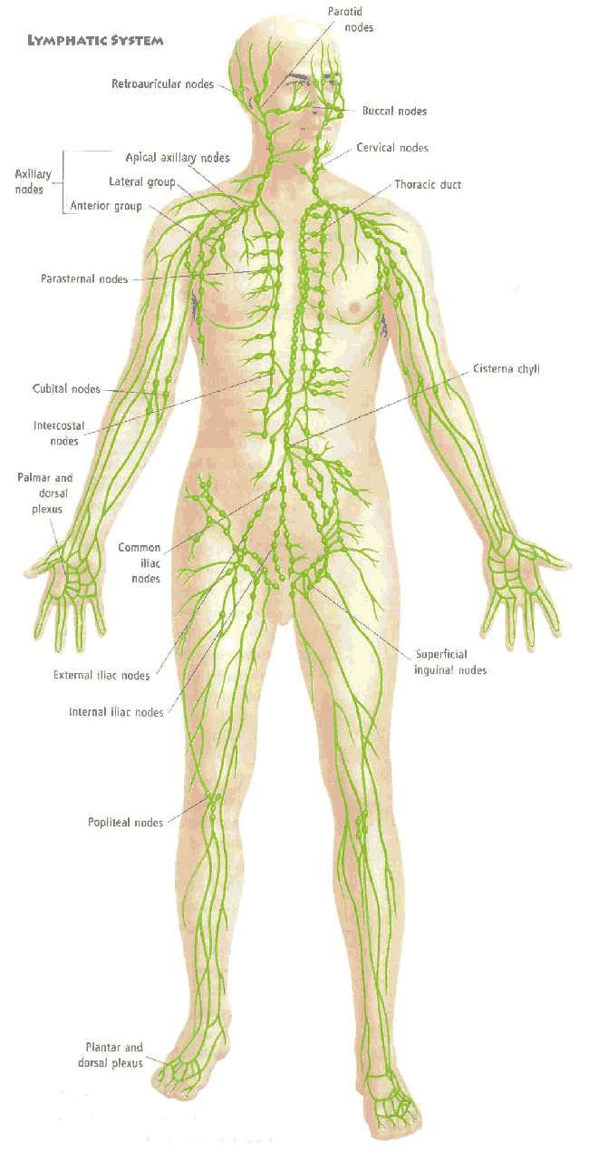
The Lymphatic System:

Slide 4
The Lymphatic System
The lymphatic system is a one-way drainage
system that extends throughout the body, returning lymph fluid to the heart through a network of lymphatic vessels and lymph nodes. The lymphatic system cleans and filters cellular waste debris, and pathogens from the interstitial fluid.
Eventually the system of lymphatic vessels end at one of two ducts, right or thoracic, that drain the cleaned and filtered lymph directly into the bloodstream and into the heart. The lymphatic system works with the circulatory system to deliver nutrients, oxygen, and hormones from the blood to the cells.

Slide 5
Functions of the Lymphatic System
Fluid balance
Protection from infection
Absorption of fats

Slide 6
How lymph travels:
Plasma→Tissues→Cells→Lymphatic capillaries→Afferent lymphatic vessels→
Lymph Nodes→Efferent lymphatic vessels→
Drainage systems→Circulatory System→Plasma

Slide 7
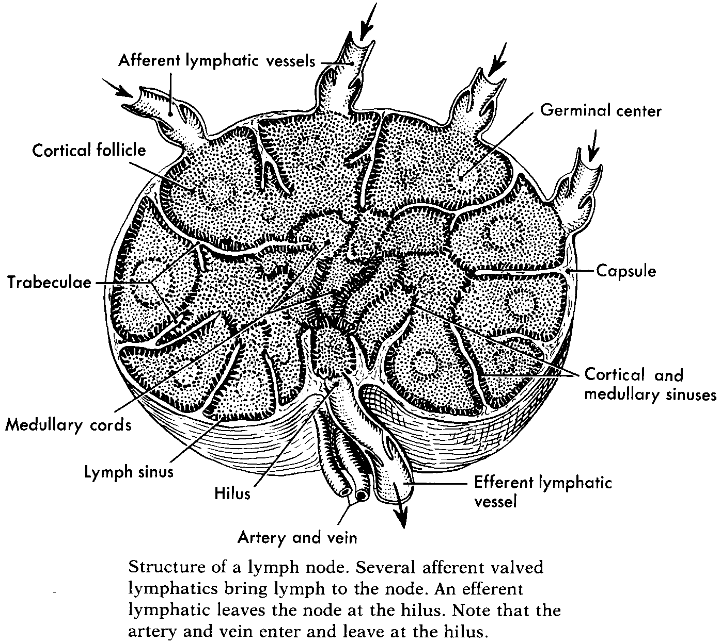
Lymph Nodes
There are between 600-700 lymph nodes present in the average human body. Lymph nodes are designed to filter lymph once it is drained from the tissues. They are the sites where lymphocytes multiply and work to fight off foreign organisms.

Slide 8
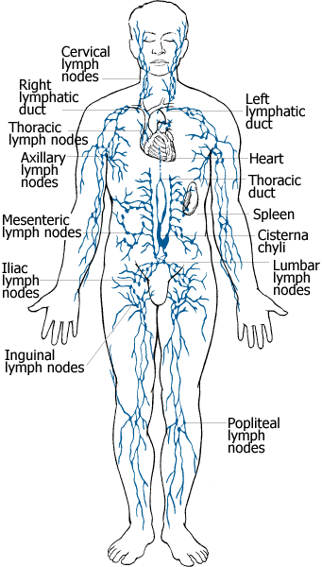
Major Lymph Nodes
Cervical Nodes
Axillary Nodes
Tracheobronchial nodes
Mesenteric
Inguinal nodes

Slide 9
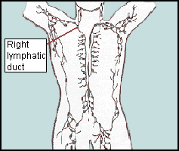
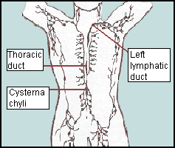
Lymphatic drainage pathways:

Slide 10
Lymphatic drainage pathways:
The right lymphatic duct drains all of the lymph from the upper right quadrant of the body, including the right arm, anterior and posterior shoulder region and the right side of the head, into the right subclavian vein.
The thoracic duct (the left lymphatic duct) drains lymph collected from the left side of the body as well as the lower trunk and both legs into the left subclavian vein.

Slide 11
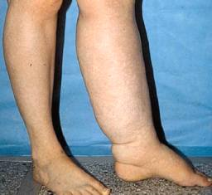
Lymphedema
A chronic disorder characterized by an abnormal accumulation of lymph fluid in the tissues of one or more body regions.

Slide 12
Classifications of Lymphedema:
Primary Lymphedema-Caused by a condition that is congenital or hereditary.
Secondary Lymphedema-Caused by injury to one or more components of the lymphatic system. Some portion of the lymph system has been blocked, dissected, fibrosed or otherwise damaged or altered.

Slide 13
Causes of Lymphedema
Primary Causes:
Milroy’s disease
Hypoplasia
Secondary Causes:
Surgery and/or radiation therapy to treat cancer.
Chronic Venous Insufficiency
Complications of Paralysis
Trauma to lymph nodes following pelvic fx, hernia repair, and other surgical interventions.

Slide 14
Clinical Presentation of lymphedema:
Swelling distal to or adjacent to the area where lymph system function has been impaired
Swelling that is usually not relieved by elevation
Pitting edema in the early stages of the disease, nonpitting edema in the later stages
Feelings of fatigue, heaviness, pressure, or tightness in the affected region
Numbness and tingling
Discomfort varying from mild to intense
Fibrotic changes of the dermis
Dermal abnormalities such as cysts, fistulas, lymphorrhea, papillomas, hyperkeratosis
Increased susceptibility to infection, at first local to the affected region but often becoming systemic.
Loss of mobility and ROM
Impaired wound healing

Slide 15
Problems associated with lymphedema:
Chronic infections
Limb loss
Angiosarcoma (a highly malignant condition)
Body image problems
Decreased range of motion
Sleep disturbances
Inability to complete family and occupational
Responsibilities
Pain
Depression

Slide 16
Aggravating factors to avoid
Excessive use of extremity
Application of local heat
Dependent position of the limb
Avoid prolonged standing or sitting.
When possible, avoid crossing legs.
Avoid footwear that is too tight

Slide 17
Risk Reduction:
Wear proper, well-fitting footwear.
Choose well-fitting garments.
Maintain optimal weight.
Gradually build the duration and intensity of any activity or exercise.
Take frequent rest periods during activity to allow for limb recovery.
Monitor the extremity during and after activity for any change in size, shape, tissue, texture, soreness, heaviness, or firmness.
Keep extremity clean and dry.
Apply moisturizer daily to prevent chapping/chaffing of skin
Assist movement of lymph.

Slide 18
The movement of lymph is assisted by:
Deep breathing
Gravity
Joint movement
Muscular contraction
General Massage
Manual lymphatic drainage

Slide 19
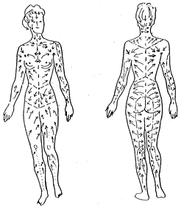
Define Manual Lymphatic Drainage (MLD):
MLD is a form of light massage in which the techniques used to stimulate lymph nodes that drain the affected part of the body and direct lymph flow around the damaged area, while encouraging drainage in the congested area.

Slide 20
Benefits of MLD:
Reduced edema
Pain relief by relieving fluid pressure on nerves
Stimulating immune function
Headache relief
Minimize scarring
Minimize connective tissue restrictions
Accelerating healing time from burns or wounds
Relieving sinus congestion
Reducing muscle hypertonicity
Improve relaxation to aid insomnia, stress, and loss of vitality.

Slide 21
Contraindications of MLD:
Edema indicating an overtaxed heart
Chronic Heart Failure
Angina
Thrombosis
Acute viral or bacterial infection
Fever
Local infection
Swollen lymph glands
Red streaks from an infection site to lymph nodes
Acute inflammation
Acute injuries
Recent surgery
Rash
Skin infections
Open wounds

Slide 22
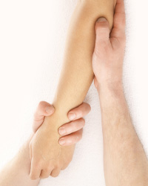
Massage strokes
Apply light and repetitive compression and effleurage strokes, repeat about 5-7 times.
The application of pressure should be about 30mmHg or the weight of a nickel resting on your skin.
Use ½ to 1 inch effleurage strokes or circular strokes.
Keep your body and hands relaxed when applying strokes.
Pressure may be applied using the ulnar border of your hand, the web space between the index finger and thumb, or pads of your thumbs.
Pumping: 3 rhythmic compression strokes
Sweeping: A series of short, superficial effleurage strokes that sweep proximally.
Work proximal to distal.

Slide 23
Basic MLD for the Head and Neck:
Place your relaxed, flat hands on the pt/client’s chest, just inferior to the clavicles, and apply 3 light compression strokes with a pumping rhythm.
Rotate the pt/clients neck to the left, supporting the head w/ your left hand, and use your right hand to apply several sets of very light pumping and sweeping to the neck, starting at the pt/client’s right clavicle and gradually moving up to the occiput.
Rotate the pt/client’s neck to the right, supporting the head with your right hand, and use your left hand to apply several sets of very light pumping and sweeping to the neck, starting at the pt/client’s left clavicle and gradually moving up to the occiput.
Apply several sets of pumping and sweeping to the client’s face, starting near the chin and gradually moving out and up to the client’s forehead.

Slide 24
Basic MLD for the UE:
Supine Arm Drainage:
1.Use flat fingers to sweep the chest, starting near the client’s sternum and gradually moving to the right axilla.
2. Gently flex and extend the pt/client’s right shoulder and elbow several times.
3. Use flat fingers to sweep the right arm, starting at the axilla and gradually moving to the hand.
4. Use flat fingers to sweep the thorax, starting at the right axilla and moving down the right side of the rib cage.
5. Repeat steps 1-4 on the left side.

Slide 25
Basic MLD for the LE:
Supine leg drainage:
Elevate the pt/client’s left leg using a bolster or pillows. If possible, gently hold and support the client’s left foot and lower leg to rhythmically flex the hip and knee several times.
Use your palms or flat fingers to pump and sweep the pt/client’s left leg, starting at the medial thigh and gradually moving to the ankle.
Repeat for the pt/client’s right leg.

Slide 26
Other ways to treat Edema:
Intermittent compression unit
Therapeutic exercise
External elastic support or gradiant support garments
Taping
Aerobic exercise
Aquatic exercise

Slide 27
Works Cited:
Braun M, Simonson S. Complementary Modalities. In: Introduction to Massage Therapy. 2nd Ed. Baltimore, MD: 2008.
Cohen B, Taylor J. The Lymphatic System and Body Defenses. In: Memmler’s Structure and Function of the Human Body. 8th Ed. Baltimore, MD: 2005.
Examining Lymphatic Drainage?. Tampa Bay Wellness [serial online]. September 2010;25(9):18. Available from: Alt HealthWatch, Ipswich, MA. Accessed June 6, 2012.
Horning K, Guhde J. Lymphedema: an under-treated problem. MEDSURG Nursing [serial online]. July 2007;16(4):221-228. Available from: CINAHL with Full Text, Ipswich, MA. Accessed June 6, 2012.
Lymphoedema... what is it exactly?. British Journal Of Community Nursing [serial online]. September 3, 2011;:4-10. Available from: CINAHL with Full Text, Ipswich, MA. Accessed June 6, 2012.
O’Sullivan S, Schmitz T. Vascular, Lymphatic, and Integumentary Disorders. In: Physical Rehabilitation. 5th Ed. Philadelphia, PA.

