Slide 1
Parkinson’s Disease: Think BIG!
Tasha Kelsch

Slide 2
Objectives:
Define Parkinson’s Disease (PD)
Discuss the epidemiology and etiology of PD
List the characteristics associated with PD
Develop an understanding of LSVT Big therapy
List the benefits of LSVT Big for people w/ PD
Interpret research studies related to LSVT Big
Recognize BIG exercises

Slide 3
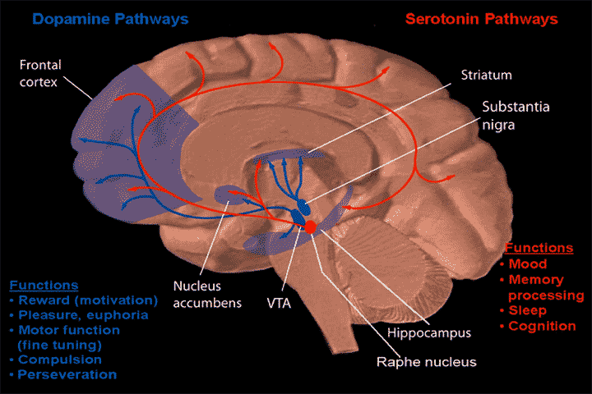
Define Parkinson’s Disease (PD):
A chronic degenerative and progressive disease of the nervous system associated with a decreased production of dopamine in the substantia niagra.

Slide 4
Facts about PD:
PD affects more than 2 percent of the population older than 65 years of age.
Average age of onset is 50-60 years.
Men and women are affected equally.
PD produces abnormalities of basal ganglia function
There are two types:
-Idiopathic
- Secondary Parkinsonism
There are two distinct clinical subgroups:
-Postural instability and gait disturbed
-Tremor predominant

Slide 5
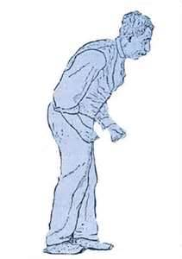
Clinical characteristics
Bradykinesia, hypokinesia, and freezing
Tremor
Postural Instability
Poor balance
Motor planning deficits
Motor learning deficits
Gait disturbances
Sensation deficits
Speech, voice, and swallowing disorders
Decreased cognitive function
Behavior problems
Autonomic nervous system dysfunction
Cardiopulmonary dysfunction
Fatigue
Depression

Slide 6
LSVT (Lee Silverman Voice Treatment)
LSVT programs have been developed and researched over the past 20 years and began with a focus on speech (LSVT Loud).
The LSVT program has recently extended to include motor systems of the limbs (LSVT Big)
LSVT Programs include:
-Increased amplitude (Loud speech and bigger limb movements)
-A focus on sensory recalibration: The brain’s automatic correcting of errors in our sensory or perceptual systems
-Training self-cuing and attention to action

Slide 7
LSVT
Neuroplasticity is defined as the capacity of nerve cells in the brain to modify their activity in response to environmental stimulation.
LSVT programs promote neuroplasticity including:
-Specificity, targeting bradykinesia and hypokinesia through increasing amplitude of motor output
-Intensity, increased dosage of treatment
-Repetition, increased repetition of tasks (minimum 15 repetitions) within treatment sessions and home practice
ADL’s: The motor exercises are directly translated into functional daily activities.

Slide 8
LSVT Big
Delivered 1:1 w/ intensive motivation and feedback. “How big does that feel?”
High intensity: Patients are encouraged to work w/ at least 80% of maximal energy on every repetition.
50% of the exercises consist of standardized whole-body movements w/ max amplitude, repetitive multidirectional movements, and stretching.
The other 50% of exercises include goal-oriented activities of daily living. ADL’s are performed using high-amplitude movements with intensive motivation and feedback.
The goal of training BIG is to teach patients to use bigger movements in routine activities to provide sustained training in everyday movements.
BIG therapy can also benefit patients with other conditions including stroke, Multiple Sclerosis, and cerebral palsy.

Slide 9
Benefits of LSVT BIG:
Improves standing balance
Increases trunk rotation
Improves ability to reach further
Increases speed and step length in gait
Improves posture
Improves body awareness
Reduces falls
Increases ROM in joints

Slide 10
Research
Comparing Exercise in Parkinson’s Disease:The Berlin LSVT BIG Study. -Movement Disorders Vol. 25 No. 12, 2010
Training BIG to move faster: The application of the speed-amplitude relation as a rehabilitation strategy for people with Parkinson’s disease. – Experimental Brain Research Vol 167 December 2005

Slide 11
Research Article: Comparing Exercise in Parkinson’s Disease:The Berlin LSVT BIG Study.
Subjects: 60 patients with mild to moderate PD
Methods: Patients were randomly assigned to receive either one-to-one training (BIG), group training of nordic walking (WALK), or unsupervised home exercises (HOME). Each group was assigned to a specific training program and was reassessed after 16 weeks. The primary efficacy of measure was the Unified Parkinson’s Disease Rating Scale (UPDRS-III) score between tx groups after week 16. Secondary outcome variables included differences in quality of life (PDQ-39), Timed up and Go (TUG), and 10 meter walk test. All tests were performed w/ medications.

Slide 12
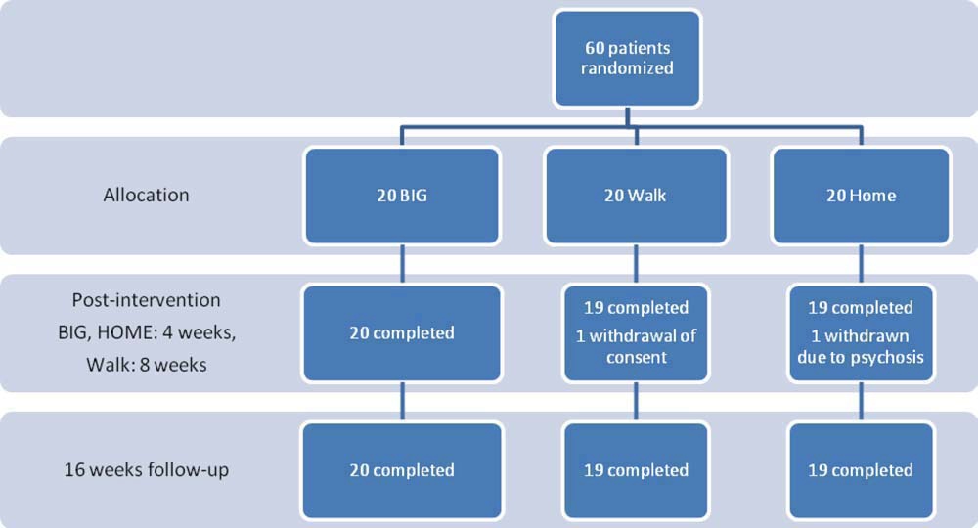
Results: LSVT BIG led to improved motor performance in patients w/ PD. UPDRS motor scores improved in the BIG group but had not improved in the WALK or HOME groups. The BIG group was also superior in TUG and 10 m walking. There were no significant group differences in quality of life (PDQ-39)

Slide 13
Research Article: Training BIG to move faster: The application of the speed-amplitude relation as a rehabilitation strategy for people with Parkinson’s disease.
Subjects: 18 volunteers w/ PD w/ no medical complications that would interfere with limb movement. The subjects had to be stable on medications w/ no other neurological diagnosis and had never participated in LSVT.
Methods: All of the subjects received 16 individual one hour BIG therapy sessions for 4 weeks. The subjects were tested one week before and one week after. Gait analysis was performed on a 14 ft electronic mat that measured velocity, cadence and stride length. Reaching was measured and videotaped. The subjects performed multijoint reaching at different distances. Wrist velocity was measured by a Butterworth filter.

Slide 14
Results: The subjects with PD increased both gait velocity and stride length after training BIG. Reaching velocity increased for the longest distances.

Slide 15
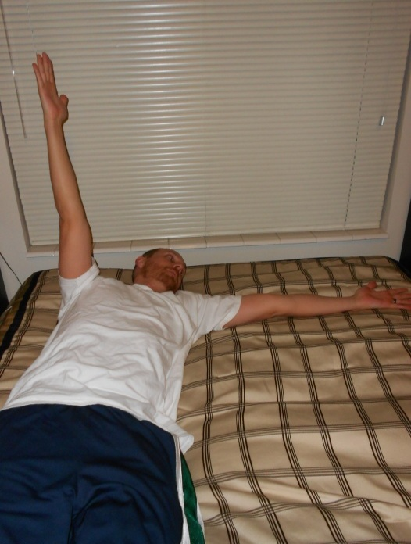
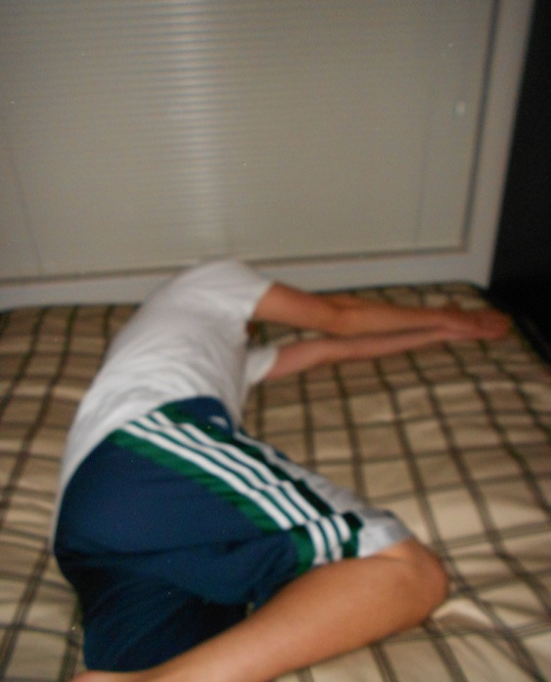
Rolling
Begin face up in bed or on a mat table w/ both arms flexed to 90°, palms touching. Drop one arm all the way out to the side. Roll towards, reaching with opposite arm as far as you are able. Repeat _____times.

Slide 16
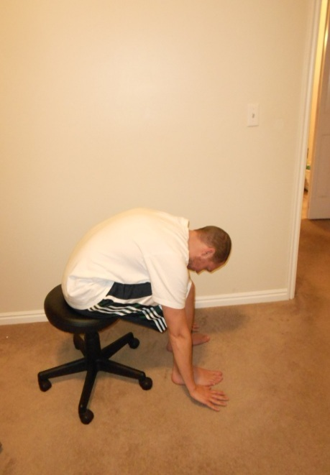
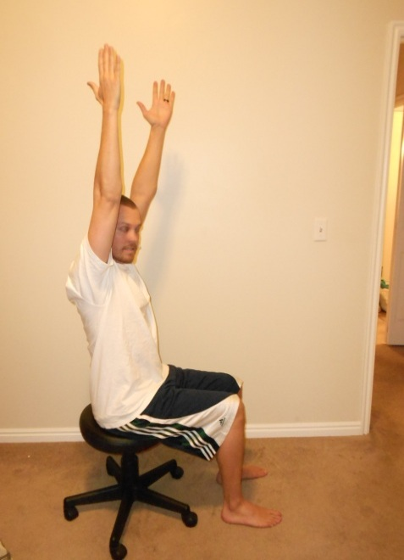
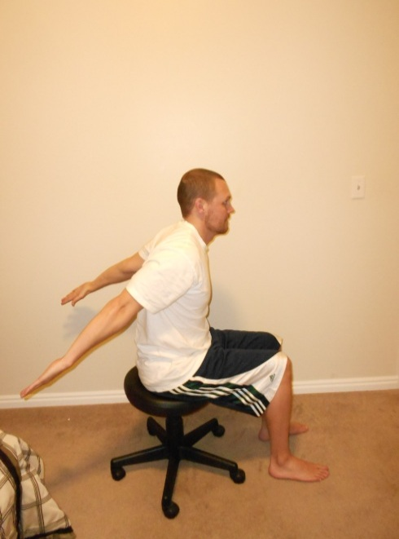
Sitting
Begin sitting in a chair with palms in lap. Reach arms as far forward as you can.
Then reach towards the floor. Next reach as high above you as you can. Last,
bring arms down to reach as far behind you as you can. Bring palms back to
lap and repeat_____times.

Slide 17
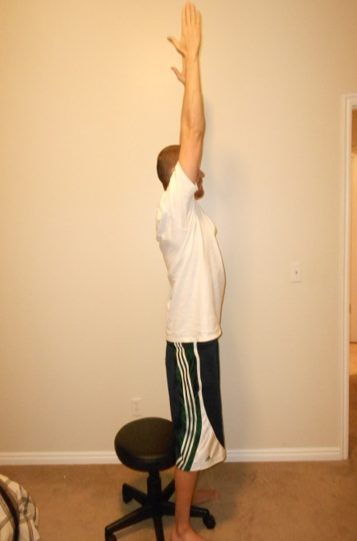
Sit to Stand
Lean forward with both feet underneath you. Push up from where you are sitting to stand up. As you come to a stand reach up with your arms as high as you can. Repeat _____times.

Slide 18
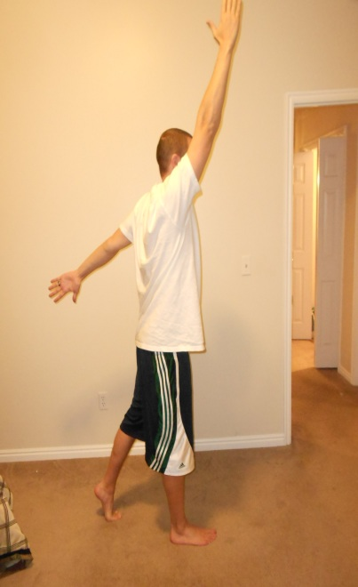
Standing/Weight Shifting
Begin with both feet flat on ground. Take a BIG step forward with right foot so that legs are scissored and spread far apart. Alternate swinging arms as high as you can with right arm foward while shifting your weight onto right foot to lift left heel. Shift your weight back onto left foot to lift right toes off ground while swinging left arm forward and right arm back. Repeat _____times, and then repeat with left foot forward.

Slide 19
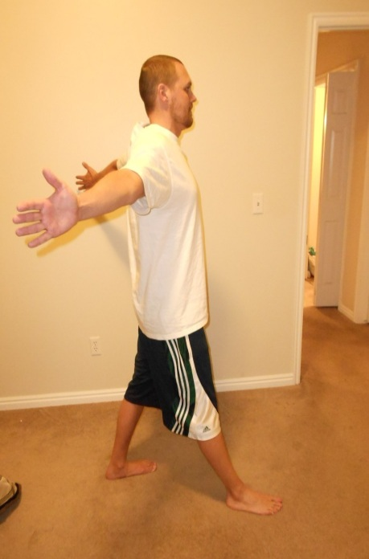
Standing/Stepping
Begin standing with feet shoulder width apart. Take a BIG step forward with right leg while spreading arms apart wide and behind you to open up chest. Bring right foot back to starting point and palms to front of thighs, then step with the left w/ same arm movement. Alternate stepping _____times.

Slide 20
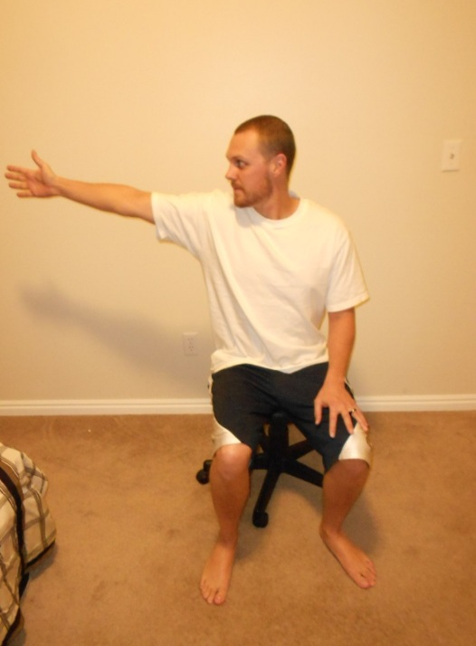
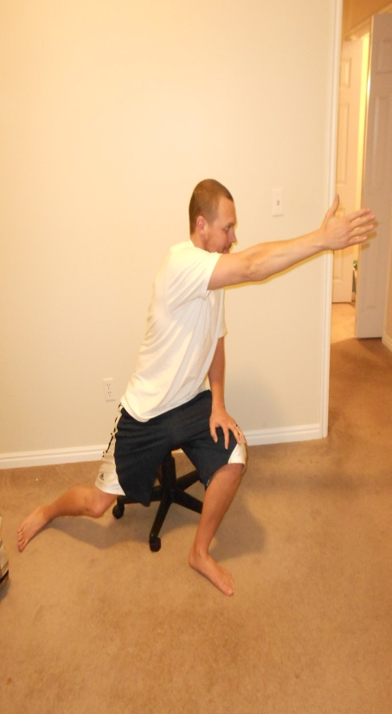
Sitting Trunk Rotation
Begin sitting with palms in lap, knees bent w/ feet flat on floor and legs spread open. Reach arm as far to the right as you can to rotate trunk. Keep arm flexed to 90°. Next rotate trunk to the left to reach with right arm to the opposite side. Slide right foot outward as you turn so that you may reach further. Bring palms back to thighs then repeat with left arm. Repeat _____times. This exercise may also be performed in standing.

Slide 21
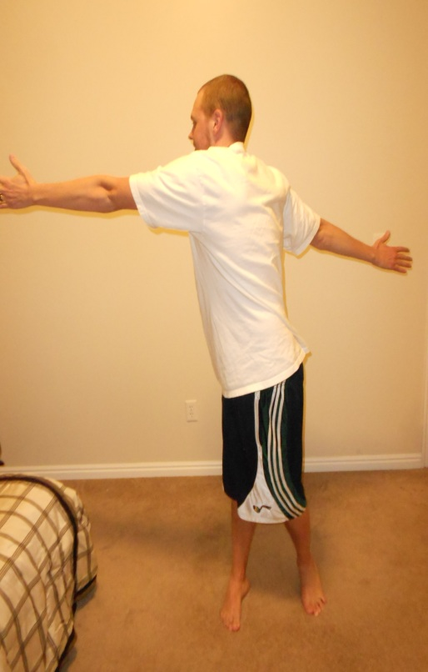
Standing Trunk Rotation
Standing with feet wide apart and arms spread apart to open chest. Rotate trunk to reach right arm far to the left while bringing left arm far behind. Repeat to reach with left arm. Alternate arms to rotate trunk left and right.

Slide 22
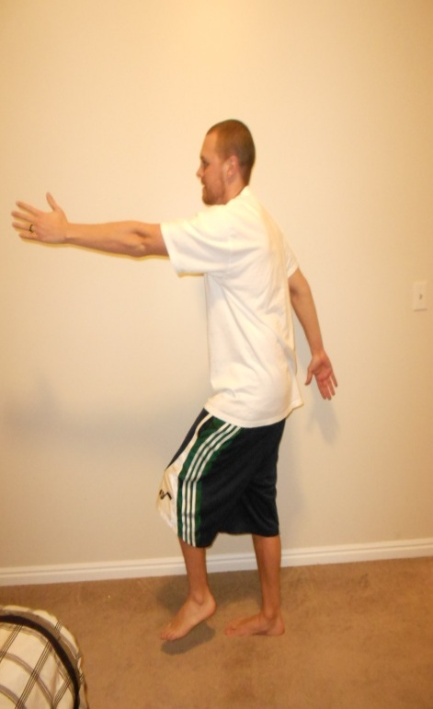
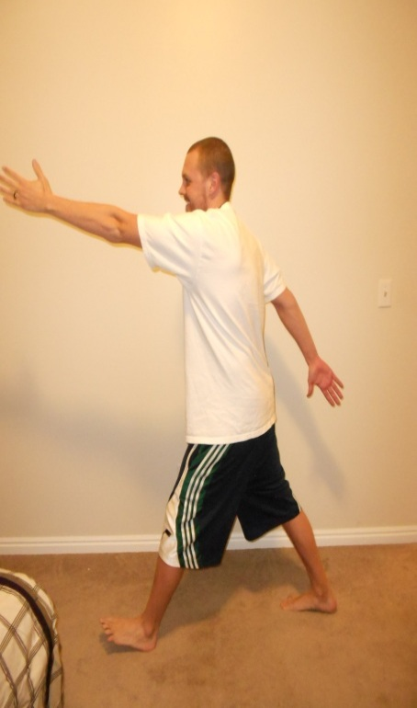
Ambulation
Take Big steps forward to walk while swinging arms as BIG as you can. Bring opposite arm and leg forward at the same time. Walk BIG for _____minutes.

Slide 23
References:
Ehab G, Barsnley S, Chellappa R. Effect of physical exercise-movement strategies programme on mobility, falls, and quality of life in Parkinson's disease. International Journal Of Therapy & Rehabilitation [serial online]. February 2012;19(2):88-96. Available from: Academic Search Premier, Ipswich, MA. Accessed November 23, 2012
Farley B, Koshland G. Training Big to move faster: The application of the speed-amplitude relation as a rehabilitation strategy for people with Parkinson’s Disease. Experimental Brain Research. Dec 2005; Vol 167.
Movement Disorders Clinic. Comparing Exercise in Parkinson’s Disease-The Berlin LSVT Big Study. Movement Disorders. 2010; Vol. 25, No. 12 pp. 1902-1908.
O’Sullivan S, Schmitz T. Physical Rehabilitation 5th Edition. Philadelphia: F.A. Davis Company; 2007.
www.lsvtglobal.com
http://www.hindawi.com/journals/pd/2012/391946/
https://www.youtube.com/watch?v=3jPEtanYmI0&feature=related
http://www.youtube.com/watch?v=cV8FjbC_MMw

