Slide 1
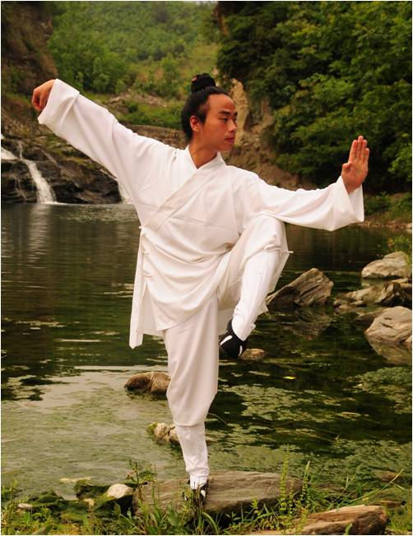
Tai Chi For Balance & Postural Control
Tasha Kelsch

Slide 2
Objectives:
Define Tai Chi
Develop an understanding of the history of Tai Chi
List the many perceived benefits of Tai Chi
List the characteristics of Tai Chi
Interpret research studies related to Tai Chi
Describe ways to progress exercises
Apply to Physical Therapy
Recognize different Tai Chi exercises

Slide 3
Define Tai Chi:
Tai Chi is a traditional Chinese exercise derived from Martial Arts. It is a low-impact exercise, of low to moderate intensity with an emphasis on balance, strength, flexibility and relaxation. It consists of slow, rhythmic movements involving shifting the center of balance. Tai Chi is often described as “meditation in motion.”
Qi (Chi) means breath, life, or energy.

Slide 4
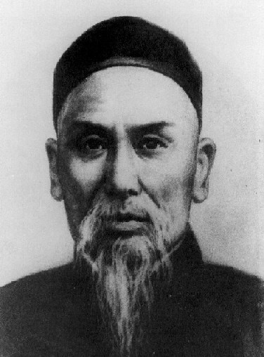
History
Tai Chi is one of the oldest forms of exercise. The slow, mindful movements have evolved from China and date back thousands of years. There are many different tales about the origin of this ancient Chinese martial art.
Snake vs. Crane
Yang style: Yang Lu Chan (1799–1872)
Deeply rooted in Taoism

Slide 5
Perceived Benefits
Prevents falls
Balance
Proprioception
Cardiorespiratory function
Posture
Flexibility
Digestion
Memory
Concentration
Relaxation
Decreased anxiety & depression
Enhance muscle function
Pain reduction
Improved gait & decreased shuffling
Lower blood pressure
Reduce the pain and stiffness of arthritis
Works the upper and lower body

Slide 6
Characteristics of Tai Chi
Low-speed and low-impact exercise
Light and steady
Core control (Drawing in)
Semi-squat posture
Should be performed barefoot
Extended and natural postures
Various foot movements
Involves coordination of all parts of the body
Consists of weight shifting, body rotation and single-leg stance
Diaphragmatic breathing w/ movements
No equipment required

Slide 7
Research
Effects of Long-Term Tai Chi Practice on Balance and H-Reflex Characteristics. –The America Journal of Chinese Medicine, 2011 Vol. 39, No. 2.
Improvement In Balance, Strength, and Flexibility After 12 Weeks of Tai Chi Exercise in Ethnic Chinese Adults With Cardiovascular Disease Risk Factors. -ALTERNATIVE THERAPIES. MAR/APR 2006, VOL 12. NO. 2
Characteristics of Foot Movement in Tai Chi Exercise. -Physical Therapy Volume 86. Number 2. Feb 2006.

Slide 8
Postural Control
Research Article: Effects of Long-Term Tai Chi Practice on Balance and H-Reflex Characteristics
Postural sway was measured using a Kistler force platform. Sixteen healthy volunteers, eight with 3+ years of experience in Tai Chi (Tai Chi Group TCG) and eight with no experience in Tai Chi (Control Group CG) participated in the study.
Each subject performed three trials of 15 seconds each under four experimental conditions: Standing still with eyes open (EO), Standing still with eyes closed (EC), Standing with head turns/ eyes open (EOT), and Standing with head turns/ eyes closed (ECT).
The TCG demonstrated 14.1%, 30.6%, 33.3% and 22.7% less postural sway.

Slide 9
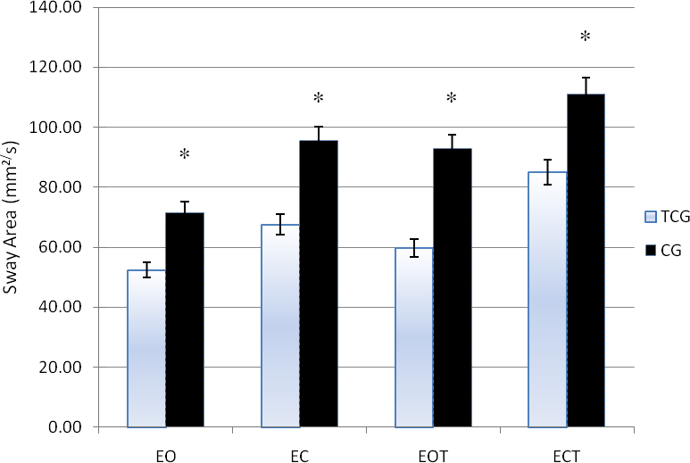
Postural Sway

Slide 10
Balance, Strength, & Flexibility
Research Article: Improvement In Balance, Strength, and Flexibility After 12 Weeks of Tai Chi Exercise in Ethnic Chinese Adults With Cardiovascular Disease Risk Factors.
Participants: Thirty-nine Chinese adults with at least 1 cardiovascular disease (CVD) risk factor.
Interventions: A 60-minute tai chi exercise class 3 times per week for 12 weeks.
Data collected at baseline, 6 weeks, and 12 weeks using a variety of functional tests.
Functional Tests:
Balance: Functional reach (in), Right single-leg stance (sec), Left single-leg stance (sec)
Strength: Arm curl (reps in 30 sec), Chair stand (number in 30 sec)
Flexibility: Back scratch (in) and Chair-sit-and-reach (in)
Results: Significant improvements were observed in all balance, muscular strength and endurance, and flexibility measures after 6 weeks, and they increased after 12 weeks.

Slide 11
Gait
Research Article: Characteristics of Foot Movement in Tai Chi Exercise.
Subjects: 16 experienced Tai Chi practitioners participated in the study.
Methods: The participants performed a whole set of 42-form TC movements. The movements were recorded with 2 cameras. A motion analysis system was used to identify the supporting and stepping characteristics of the foot.
Results: Seven foot support patterns and 6 step directions were identified.
Conclusion: Support patterns changed slowly, and combined with various step directions, they were found to be better than those of walking in simulating the gait challenges that may be encountered in daily activities.

Slide 12
Characteristics of foot movements
Foot support patterns: Full double-limb support, left single-leg stance, right single-leg stance, left support with right toe touch, left support with right heel touch, right support with left toe touch, and right support with left heel touch.
Categories of step direction: Stepping forward, stepping backward, stepping sideways, up and down stepping (High march), Turning/ pivotal rotation, and fixed step.

Slide 13
Progression of exercise
Sitting position
Sitting on dyna disc or foam pad
Kneeling/Half-Kneeling
Standing
Adjust intensity of exercise by controlling angle of the knee (High squat or low squat)
Even/Uneven surface
Standing with medi ball, kettle ball or using theraband or weights

Slide 14
Tai Chi & Physical Therapy
Easily integrated
A large variety of moves that can be modified
Great for elderly patients in reducing the risk of falls
Can be used with all age groups to improve balance, posture, and gait.
Beneficial for a variety of diagnoses
Closed-Chain/ Unloaded
Strengthens UE’s, LE’s & Core
Works multiple joints simultaneously
Easily modified or progressed
No equipment necessary/ HEP

Slide 15
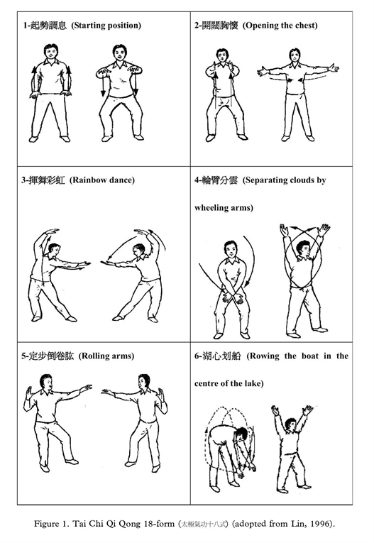
Tai Chi Qi Qong 18-form

Slide 16
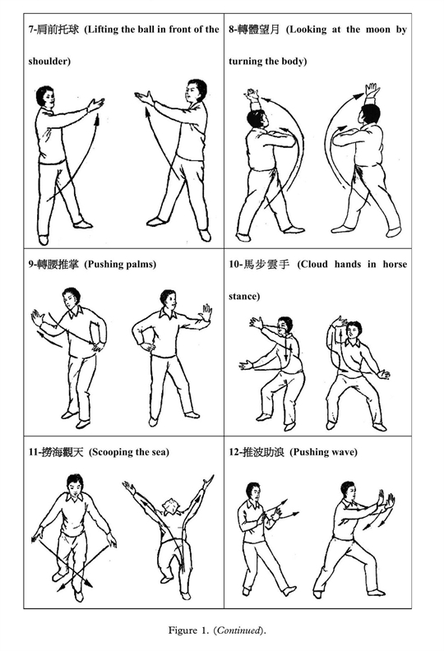

Slide 17
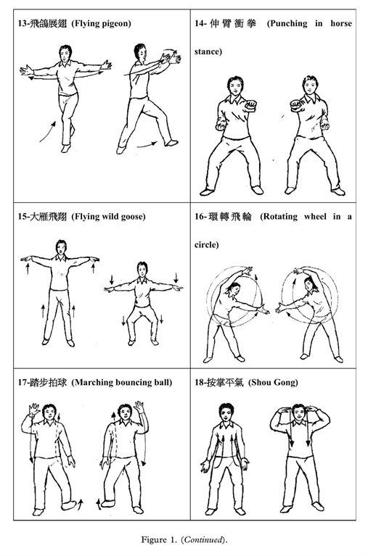

Slide 18
Works Cited:
Biscontini L. The Oldest Mindful Exercise. American Fitness [serial online]. January 2010;28(1):12-13. Available from: Academic Search Premier, Ipswich, MA. Accessed September 27, 2012.
Leung E, Tsang W. Comparison of the kinetic characteristics of standing and sitting Tai Chi forms. Disability & Rehabilitation [serial online]. December 15, 2008;30(25):1891-1900. Available from: Academic Search Premier, Ipswich, MA. Accessed September 27, 2012.
De Wei M, Youlian H, Jing Xian L. Characteristics of Foot Movement in Tai Chi Exercise. Physical Therapy [serial online]. February 2006;86(2):215-222. Available from: Academic Search Premier, Ipswich, MA. Accessed September 27, 2012.
Guan H, Koceja D. Effects of Long-Term Tai Chi Practice on Balance and H-Reflex Characteristics. American Journal Of Chinese Medicine [serial online]. April 2011;39(2):251-260. Available from: Academic Search Premier, Ipswich, MA. Accessed September 28, 2012.
Lan C, Lai J, Chen S. Tai Chi Chuan: An Ancient Wisdom on Exercise and Health Promotion. Sports Medicine [serial online]. February 15, 2002;32(4):217-224. Available from: Academic Search Premier, Ipswich, MA. Accessed September 29, 2012.
Taylor-Piliae R, Haskell W, Stotts N, Froelicher E. IMPROVEMENT IN BALANCE, STRENGTH, AND FLEXIBILITY AFTER 12 WEEKS OF TAI CHI EXERCISE IN ETHNIC CHINESE ADULTS WITH CARDIOVASCULAR DISEASE RISK FACTORS. Alternative Therapies In Health & Medicine [serial online]. March 2006;12(2):50-58. Available from: Academic Search Premier, Ipswich, MA. Accessed September 27, 2012.
The health benefits of tai chi. Harvard Women's Health Watch [serial online]. May 2009;16(9):2-4. Available from: Academic Search Premier, Ipswich, MA. Accessed September 27, 2012.
http://www.tai-chi-wizard.com/history-of-tai-chi.html#Yang-Lu-chan.

